Slide 1
BirdBox Learning Management System
Group MEMBERS:
Omer Mir, Marbin Gonzalez, Monika Sharma, Min Thiha Myo, and Francisco Mokuy

Slide 2
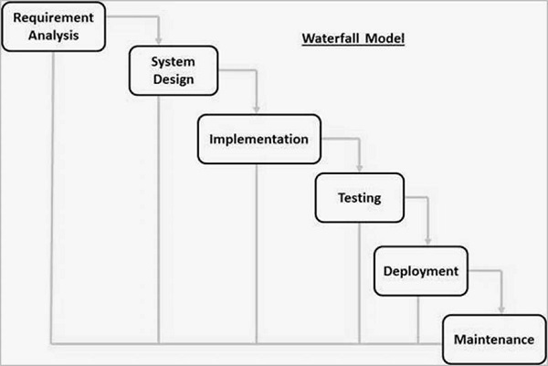
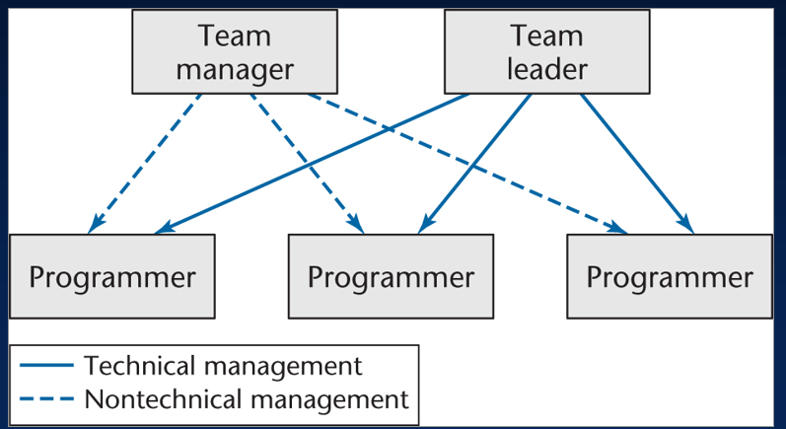
Waterfall Model w/ Democratic Team Approach

Slide 3
Roles
Omer Mir - Team Leader
Monika Sharma - Team Manager
Min Thiha Myo - Chief Programmer
Marbin Gonzalez - Programmer
Francisco Mokuy - Programmer

Slide 4
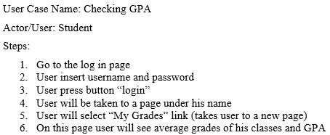
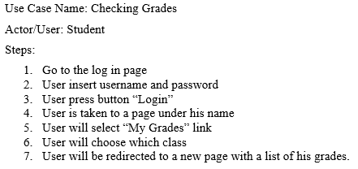
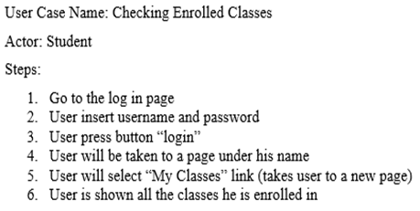
USE CASES

Slide 5
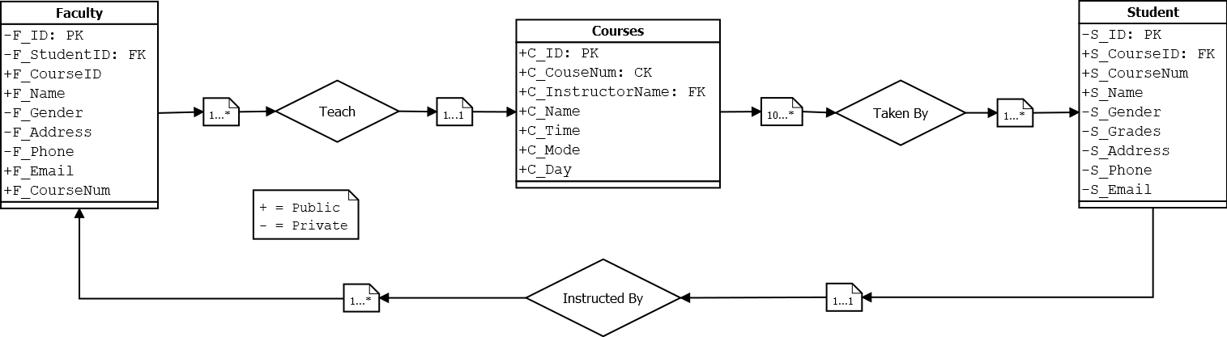
UML Diagram

Slide 6
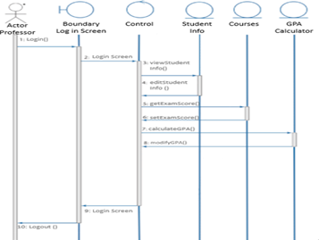
Sequence Diagram

Slide 7
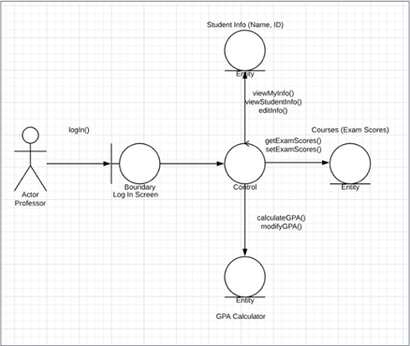
Collaboration Diagram

Slide 8



Tools we are using
IDE used: NetBeans 8.2
Programming language: Java
Using Xampp Apache for database and storage
ArgoUML application for UML diagram
JFrames for GUI Framework
JUnit 5 for testing

Slide 9
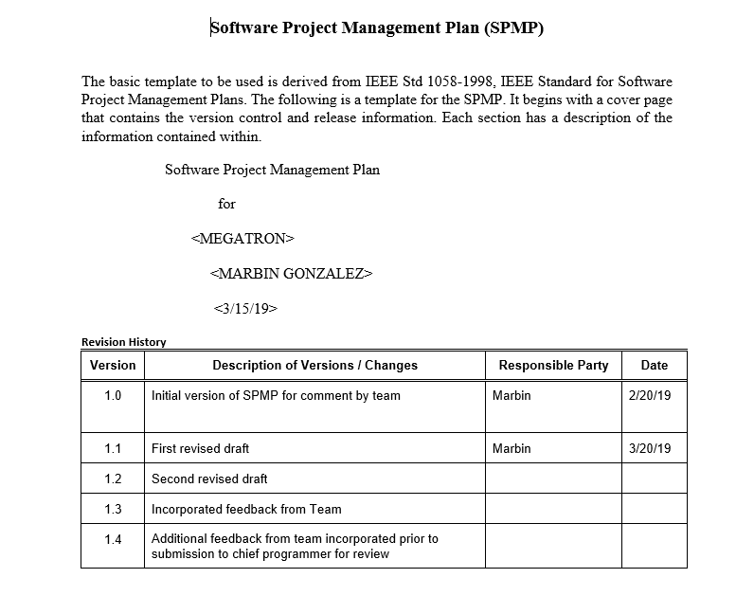
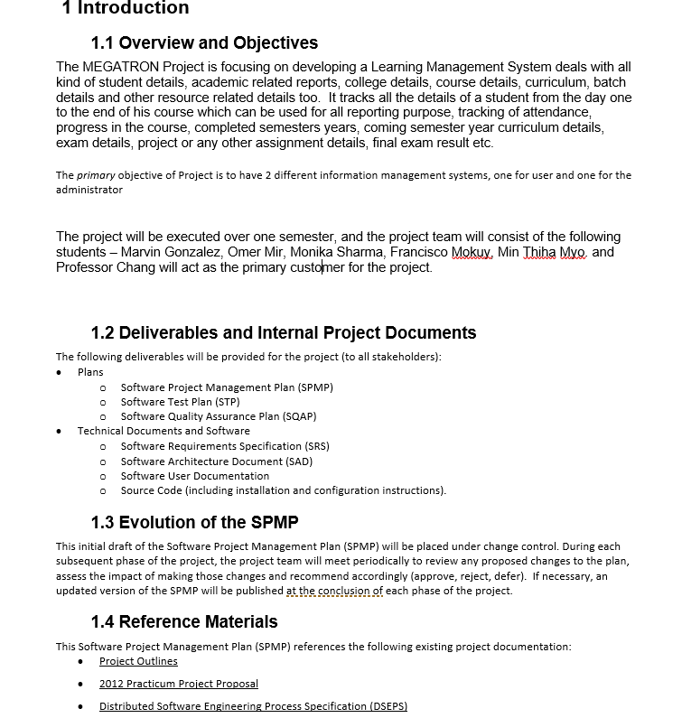
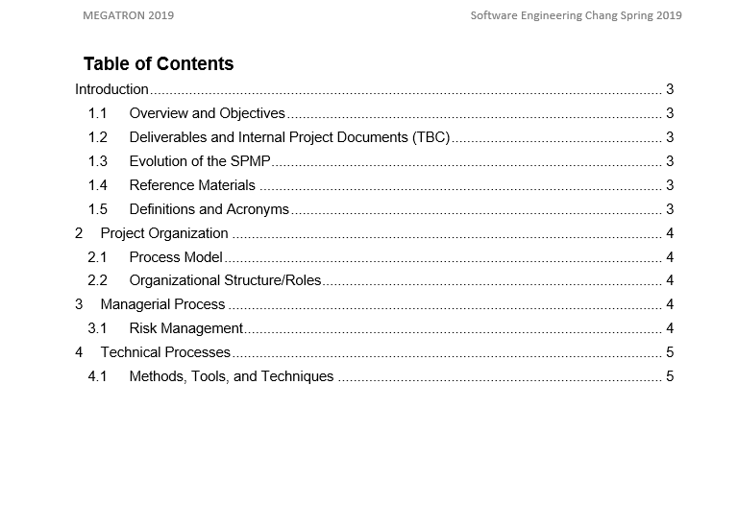
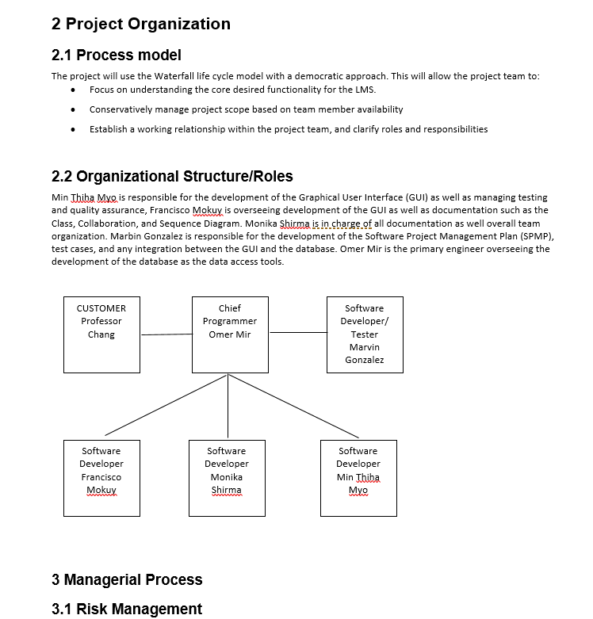
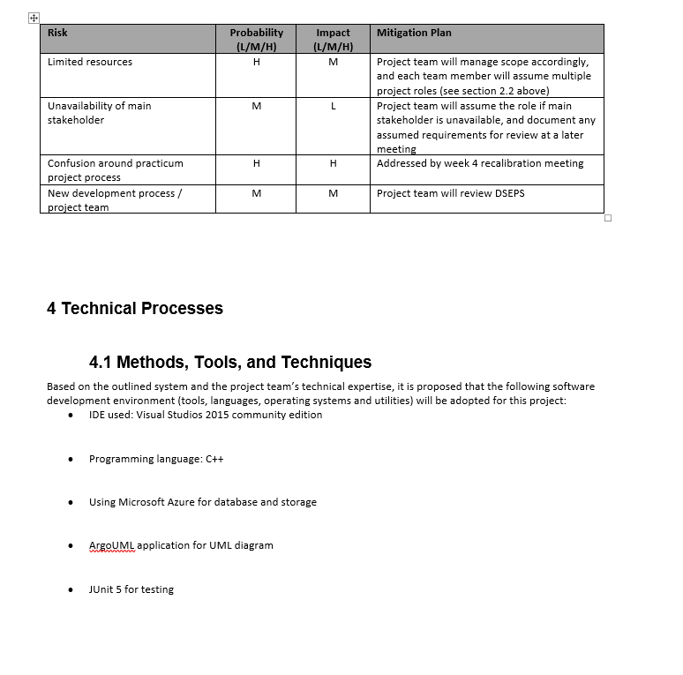
SPMP
https://github.com/omermir01/MegaTron/commit/ea91517020095206b082054cba9d894c56b52b74

Slide 10
Student Collaborators
First Name Last Name Student ID Student Password GPA Class 1 Class 2 Class 3 Class 1 Grade Class 2 Grade Class 3 Grade | Courses
CRC CARDS - Class Responsibility Collaborators
Class Collaborators
Responsibilities : A Responsibility is anything that a class knows or does. | A class often does not have enough infp to complete it responsibility so, it must collaborate with another class to fulfill, so it either request information or request to perform a task.
Courses Collaborators
Course Number Course ID Name Instructor Department Day Start End | Instructor Student
Instructor Collaborators
First Name Last Name Instructor ID Department Position Office Number of Classes | Courses

Slide 11
GitHub Link
https://github.com/omermir01/MegaTron

Slide 12
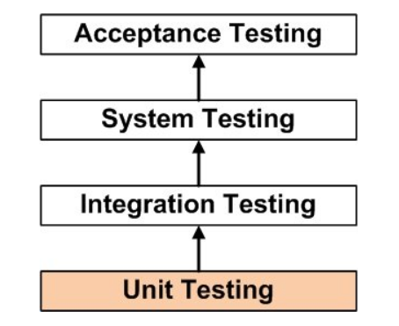
Testing
UNIT TESTING is a level of software testing where individual units/ components of a software are tested. The purpose is to validate that each unit of the software performs as designed.
INTEGRATION TESTING is a level of software testing where individual units are combined and tested as a group. The purpose of this level of testing is to expose faults in the interaction between integrated units.
PRODUCT TESTING is the testing of a complete and fully integrated software product.

Slide 13
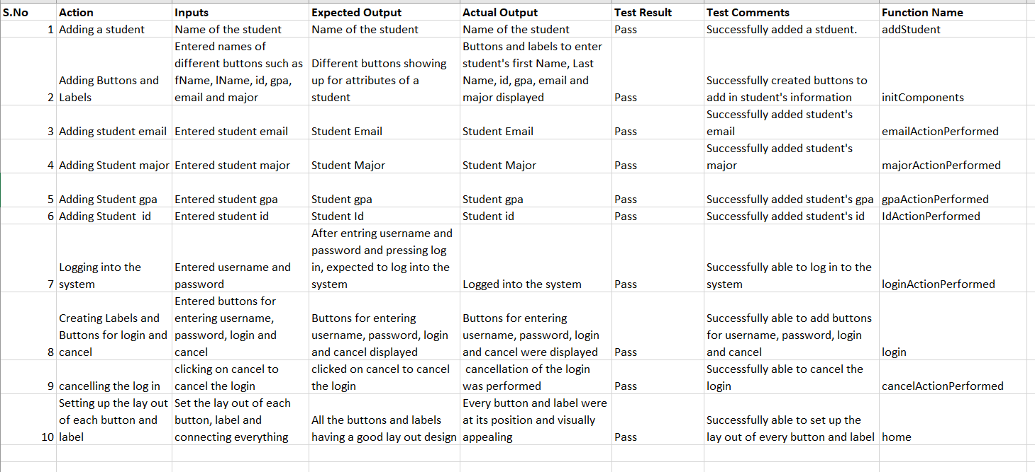
Unit Testing

Slide 14
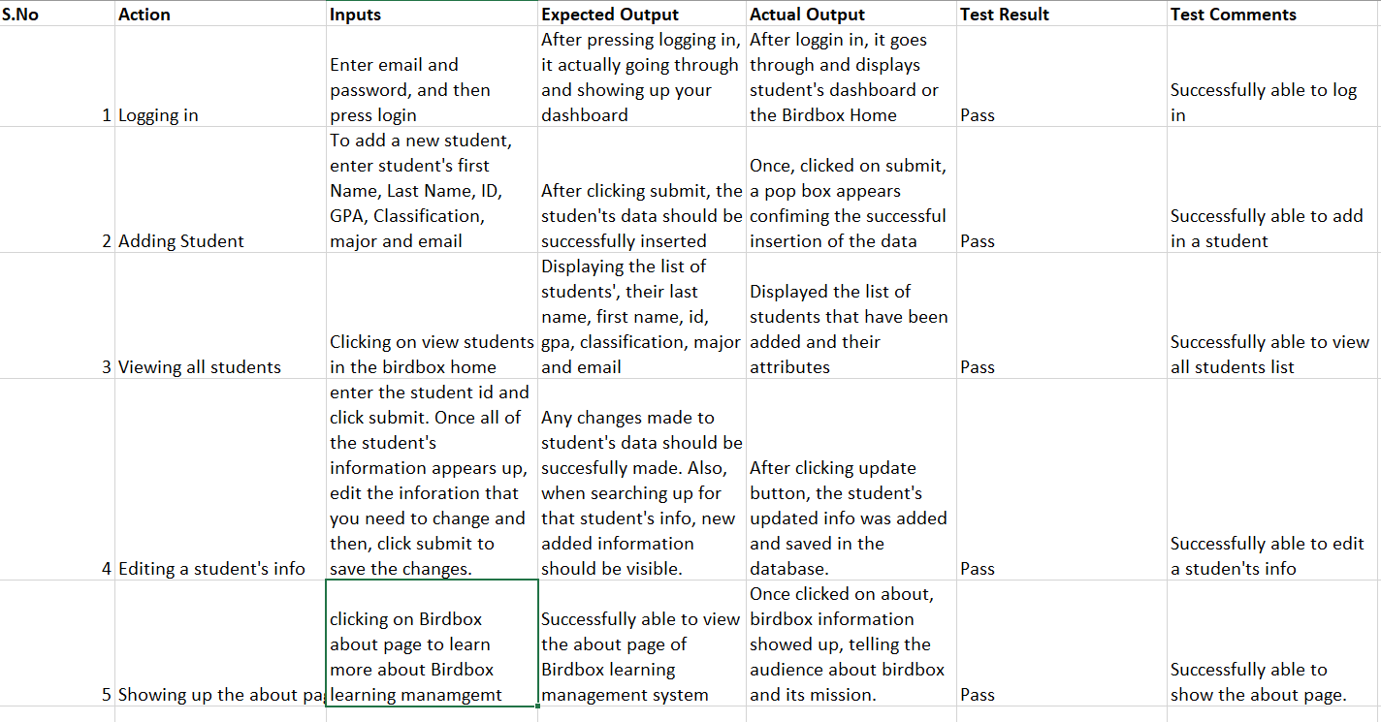
Integration Testing

Slide 15
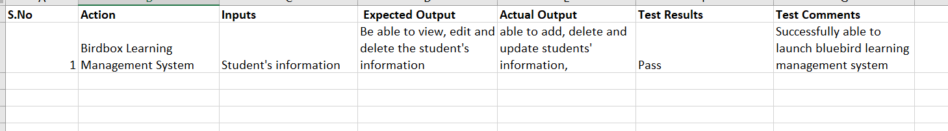
Product Testing

Slide 16
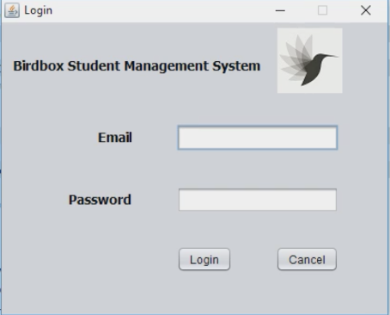
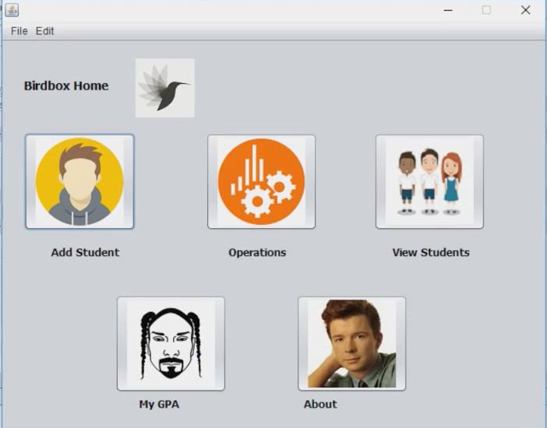
BirdBox Learning Management System

